Slide 1
AWS – Module 1
AWS Fundamentals
Storage Classes

Slide 2
Table of Contents
AWS Fundamentals
Simple Storage Service – S3
AWS S3 LAB

Slide 3
AWS Certifications

Slide 4
AWS Cloud Computing - Platform

Slide 5
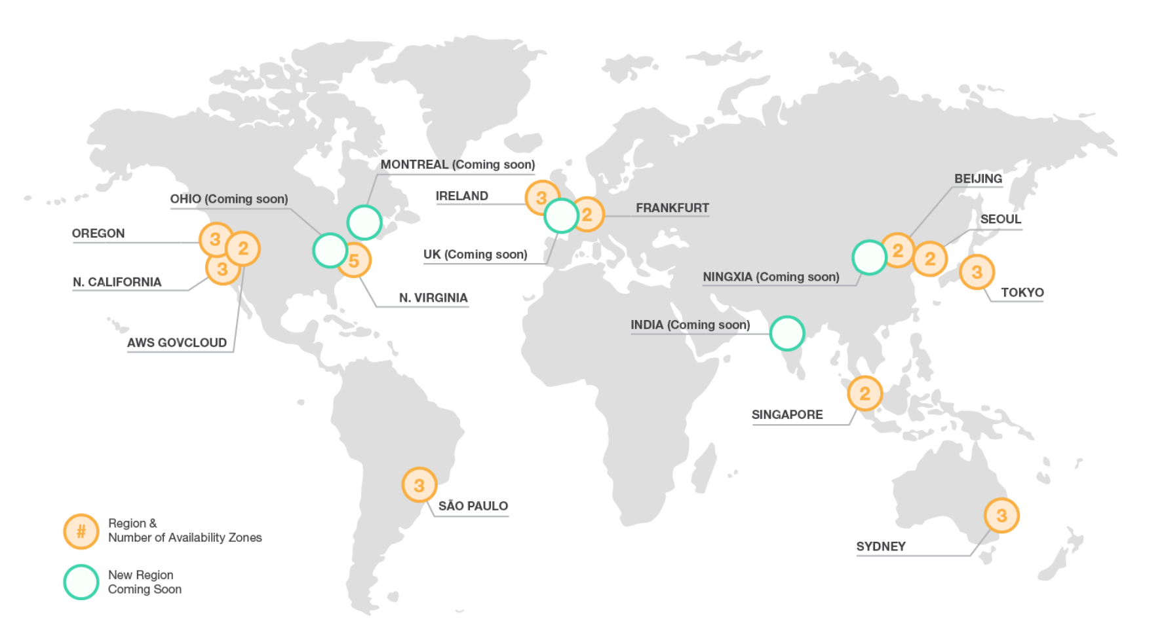
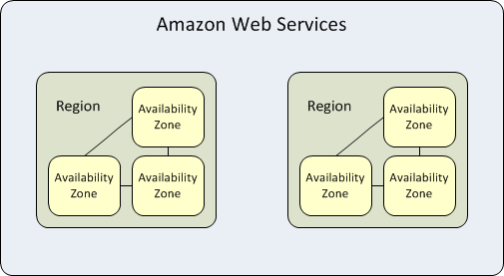
AWS Regions and Availability Zones
AWS provides on-demand delivery of IT resources via the Internet on a secure cloud services platform, offering compute power, storage, databases, content delivery, and other functionality to help businesses scale and grow.
AWS provides a highly available technology infrastructure platform with multiple locations worldwide. These locations are composed of regions and Availability Zones.
http://docs.aws.amazon.com/AWSEC2/latest/UserGuide/using-regions-availability-zones.html#concepts-available-regions

Slide 6
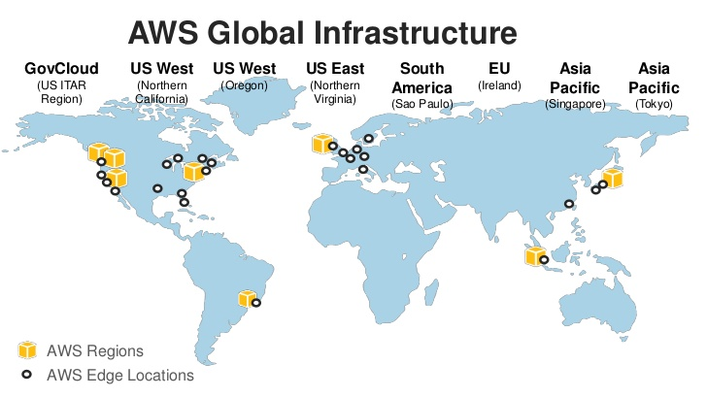
AWS Edge Locations
An edge location is where end users access services located at AWS. They are located in most of the major cities around the world and are specifically used by CloudFront (CDN) to distribute content to end user to reduce latency. It is like frontend for the service we access which are located in AWS cloud. Below are some of the Edge locations as of this writing.
http://docs.aws.amazon.com/AWSEC2/latest/UserGuide/using-regions-availability-zones.html#concepts-available-regions

Slide 7
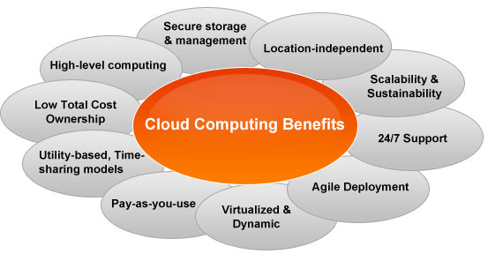
AWS Cloud Computing - Benefits

Slide 8
Exam - Tips
Understand the global infrastructure. AWS provides a highly available technology infrastructure platform with multiple locations worldwide. These locations are composed of regions and Availability Zones. Each region is located in a separate geographic area and has multiple, isolated locations known as Availability Zones.
Understand regions. An AWS region is a physical geographic location that consists of a cluster of data centers. AWS regions enable the placement of resources and data in multiple locations around the globe. Each region is completely independent and is designed to be completely isolated from the other regions. This achieves the greatest possible fault tolerance and stability. Resources aren’t replicated across regions unless organizations choose to do so.
Understand Availability Zones. An Availability Zone is one or more data centers within a region that are designed to be isolated from failures in other Availability Zones. Availability Zones provide inexpensive, low-latency network connectivity to other zones in the same region. By placing resources in separate Availability Zones, organizations can protect their website or application from a service disruption impacting a single location.
Understand the hybrid deployment model. A hybrid deployment model is an architectural pattern providing connectivity for infrastructure and applications between cloud-based resources and existing resources that are not located in the cloud.

Slide 9
Simple Storage Service (S3)

Slide 10

















AWS Storage Type
Amazon EFS
Amazon Glacier
Amazon S3
AWS Snowball
AWS Storage Gateway
EFS share
archive
bucket
import/ export
cached volume
Amazon EBS
vault
bucket with objects
non-cached volume
snapshot
object
virtual tape library
volume

Slide 11
AWS S3 – Fundamentals
Amazon S3 provides developers and IT teams with secure, durable, and highly-scalable cloud storage
Amazon S3 is easy-to-use object storage with a simple web service interface that you can use to store and retrieve any amount of data from anywhere on the web.
Amazon S3 also allows you to pay only for the storage you actually use, which eliminates the capacity planning and capacity constraints associated with traditional storage.
Amazon S3 can be used alone or in conjunction with other AWS services, and it offers a very high level of integration with many other AWS cloud services. For example, Amazon S3 serves as the durable target storage for Amazon Kinesis and Amazon Elastic MapReduce (Amazon EMR), it is used as the storage for Amazon Elastic Block Store (Amazon EBS) and Amazon Relational Database Service (Amazon RDS) snapshots, and it is used as a data staging or loading storage mechanism for Amazon Redshift and Amazon DynamoDB, among many other functions.

Slide 12
AWS S3 – Fundamentals
Common use cases for Amazon S3 storage include:
Backup and archive for on-premises or cloud data
Content, media, and software storage and distribution
Big data analytics
Static website hosting
Cloud-native mobile and Internet application hosting
Disaster recovery

Slide 13
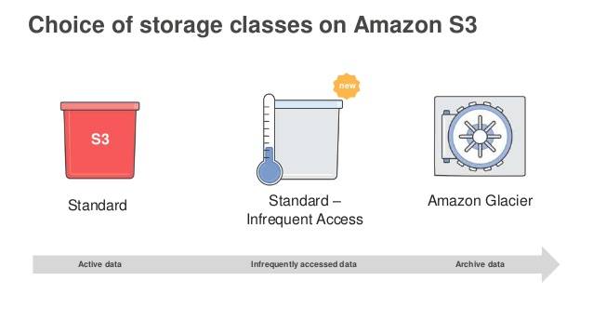
AWS S3 Storage Classes

Slide 14
AWS S3 - Standard
Amazon S3 Standard is designed for high-usage, “hot” data storage and has the following features:
High capacity and low latency;
Reliability at 99,999999999% level (of 100 billion objects per year, you are at risk of losing only one of them).
Availability at 99,99% level (of 10 thousand hours, within one hour the data will be unavailable) .
Use of the storage is covered by Amazon S3 Service Level Agreement, which considers a compensation, if the level of uninterrupted operation is lower than it was declared.
Standard storage is suitable for the following usage scenarios:
Website hosting
Cloud applications and web-services
Mobile games and apps
Big data
Content distribution

Slide 15
AWS S3 – Infrequent Access (IA)
Amazon S3 IA is designed for the data which require less frequent access, but with longer storage time than in case of Standard.
Low delays combined with high capacity and reliability 99,999999999% insure safety of object for a long period of time. Amazon S3 IA differs from Standard in the following way:
Availability at 99.9% level within a year (e.g., probability of request error is a little higher than in standard storage)
You are charged for data retrieval
Minimum storage period is 30 days, and minimum size of the object is 128 KB.
The storage is recommended for long storage of files, disaster recovery data, backup, outdated sync data. As a rule, they require access relatively rarely, but, if necessary must be accessed quickly.

Slide 16
Reduced Redundancy Storage (RRS)
Reduced Redundancy Storage (RRS) is an Amazon S3 storage option that enables customers to store noncritical, reproducible data at lower levels of redundancy than Amazon S3’s standard storage. It provides a highly available solution for distributing or sharing content that is durably stored elsewhere, or for storing thumbnails, transcoded media, or other processed data that can be easily reproduced. The RRS option stores objects on multiple devices across multiple facilities, providing 400 times the durability of a typical disk drive, but does not replicate objects as many times as standard Amazon S3 storage.
Reduced Redundancy Storage is Backed with the Amazon S3 Service Level Agreement for availability. Designed to provide 99.99% durability and 99.99% availability of objects over a given year. This durability level corresponds to an average annual expected loss of 0.01% of objects. Designed to sustain the loss of data in a single facility.
This solution is perfect for uncritical or easily replicable data of different apps: dynamic websites, business-applications, etc. For example, you can use Amazon S3 Standard for keeping images, and S3 RRS — for their previews

Slide 17
S3 - Glacier
Amazon Glacier is a perfect solution for long storage and archiving of data which don’t require instant access. The service allows to store large or small volumes of data at low cost. At the same time, the retrieval process may take several hours.
Amazon Glacier differs from S3 Standard in the following way:
Extremely low cost.
Uninterrupted operation is not guaranteed by Amazon S3 Service Level Agreement.
Minimum period of storage is 90 days.
There is a charge for data retrieval of more than than 10 GB free tier per month. Access to data is limited depending on the chosen retrieval options (expedite retrieval - 1-5 minutes, standard - 3-5 hours, bulk - 5-12 hours) The service is optimized for the data, for which the access is rarely required, with admissible retrieval time of several hours.
Typical example of use is storage of data archives:
Media resources archives (news bulletins)
Archives of organizations working in health area (patients information)
Data obtained during scientific researches
Backup copies of databases with long storage
Replacement of analog media
You can save objects directly in Glacier or set a Lifecycle Policy on your S3 bucket to automatically archive data.

Slide 18
AWS S3 – Characteristics Table
Characteristics | S3 Standard | S3 RRS | S3 Standard IA | Glacier
Redundancy | 99.999999999% | 99.99% | 99.999999999% | 99.999999999%
Availability | 99.99% | 99.99% | 99.99% | N/A
Minimum Period of storage | Unlimited | Unlimited | 30 days | 90 days
Minimum Size of Object | Unlimited | Unlimited | 128Kb | Unlimited
Access to object | Milliseconds | Milliseconds | Milliseconds | 1Min to 12 Hrs (Depends on the Retrieval Options)
Charge for Data Retrieval | None | None | Per GB of the Data Received | 10 GB per month free, then per GB of the data retrieved

Slide 19
AWS S3 – Life Cycle Policies
All Amazon S3 classes are supported by life cycle policy.
It means that you can optimize the storage costs for the objects by setting the rules of their automatic transference to cheaper storage.
It is also possible to set up the life cycle termination policy so that the files were automatically removed after a certain period.
For example, you can save a data in Amazon S3 Standard, in a certain time transfer them to Standard IA storage, and then- to Glacier. Sometime later they can be removed or placed to archive storage.

Slide 20
AWS S3 - Security
Amazon S3 supports user authentication to control access to data. You can use access control mechanisms such as bucket policies and Access Control Lists (ACLs) to selectively grant permissions to users and groups of users.
You can securely upload/download your data to Amazon S3 via SSL endpoints using the HTTPS protocol.
If you need extra security you can use the Server Side Encryption (SSE) option or the Server Side Encryption with Customer-Provide Keys (SSE-C) option to encrypt data stored-at-rest.
Amazon S3 provides the encryption technology for both SSE and SSE-C. Alternatively you can use your own encryption libraries to encrypt data before storing it in Amazon S3.

Slide 21
AWS S3 – Security Encryption for Data at Rest
Encrypt data using SSE-S3, SSE-C, SSE-KMS, or a client library such as the Amazon S3 Encryption Client.
SSE-S3 provides an integrated solution where Amazon handles key management and key protection using multiple layers of security. You should choose SSE-S3 if you prefer to have Amazon manage your keys.
SSE-C enables you to leverage Amazon S3 to perform the encryption and decryption of your objects while retaining control of the keys used to encrypt objects
SSE-KMS enables you to use AWS Key Management Service (AWS KMS) to manage your encryption keys.
AWS KMS provides an audit trail so you can see who used your key to access which object and when, as well as view failed attempts to access data from users without permission to decrypt the data.
http://docs.aws.amazon.com/AmazonS3/latest/dev/serv-side-encryption.html

Slide 22
Exam Tips
AWS S3 – Unlimited Object based Storage
Most Durable & Reliable Platform for Your Data
Maximum Object Storage size 5 TB
Remember Storage Classes – Standard S3, IA(Infrequent Access), Reduced Redundancy Storage (RRS) & Glacier
Understand for which type you will use Different Storage classes

Slide 23
Simple Storage Service (S3) LAB

